Slide 1
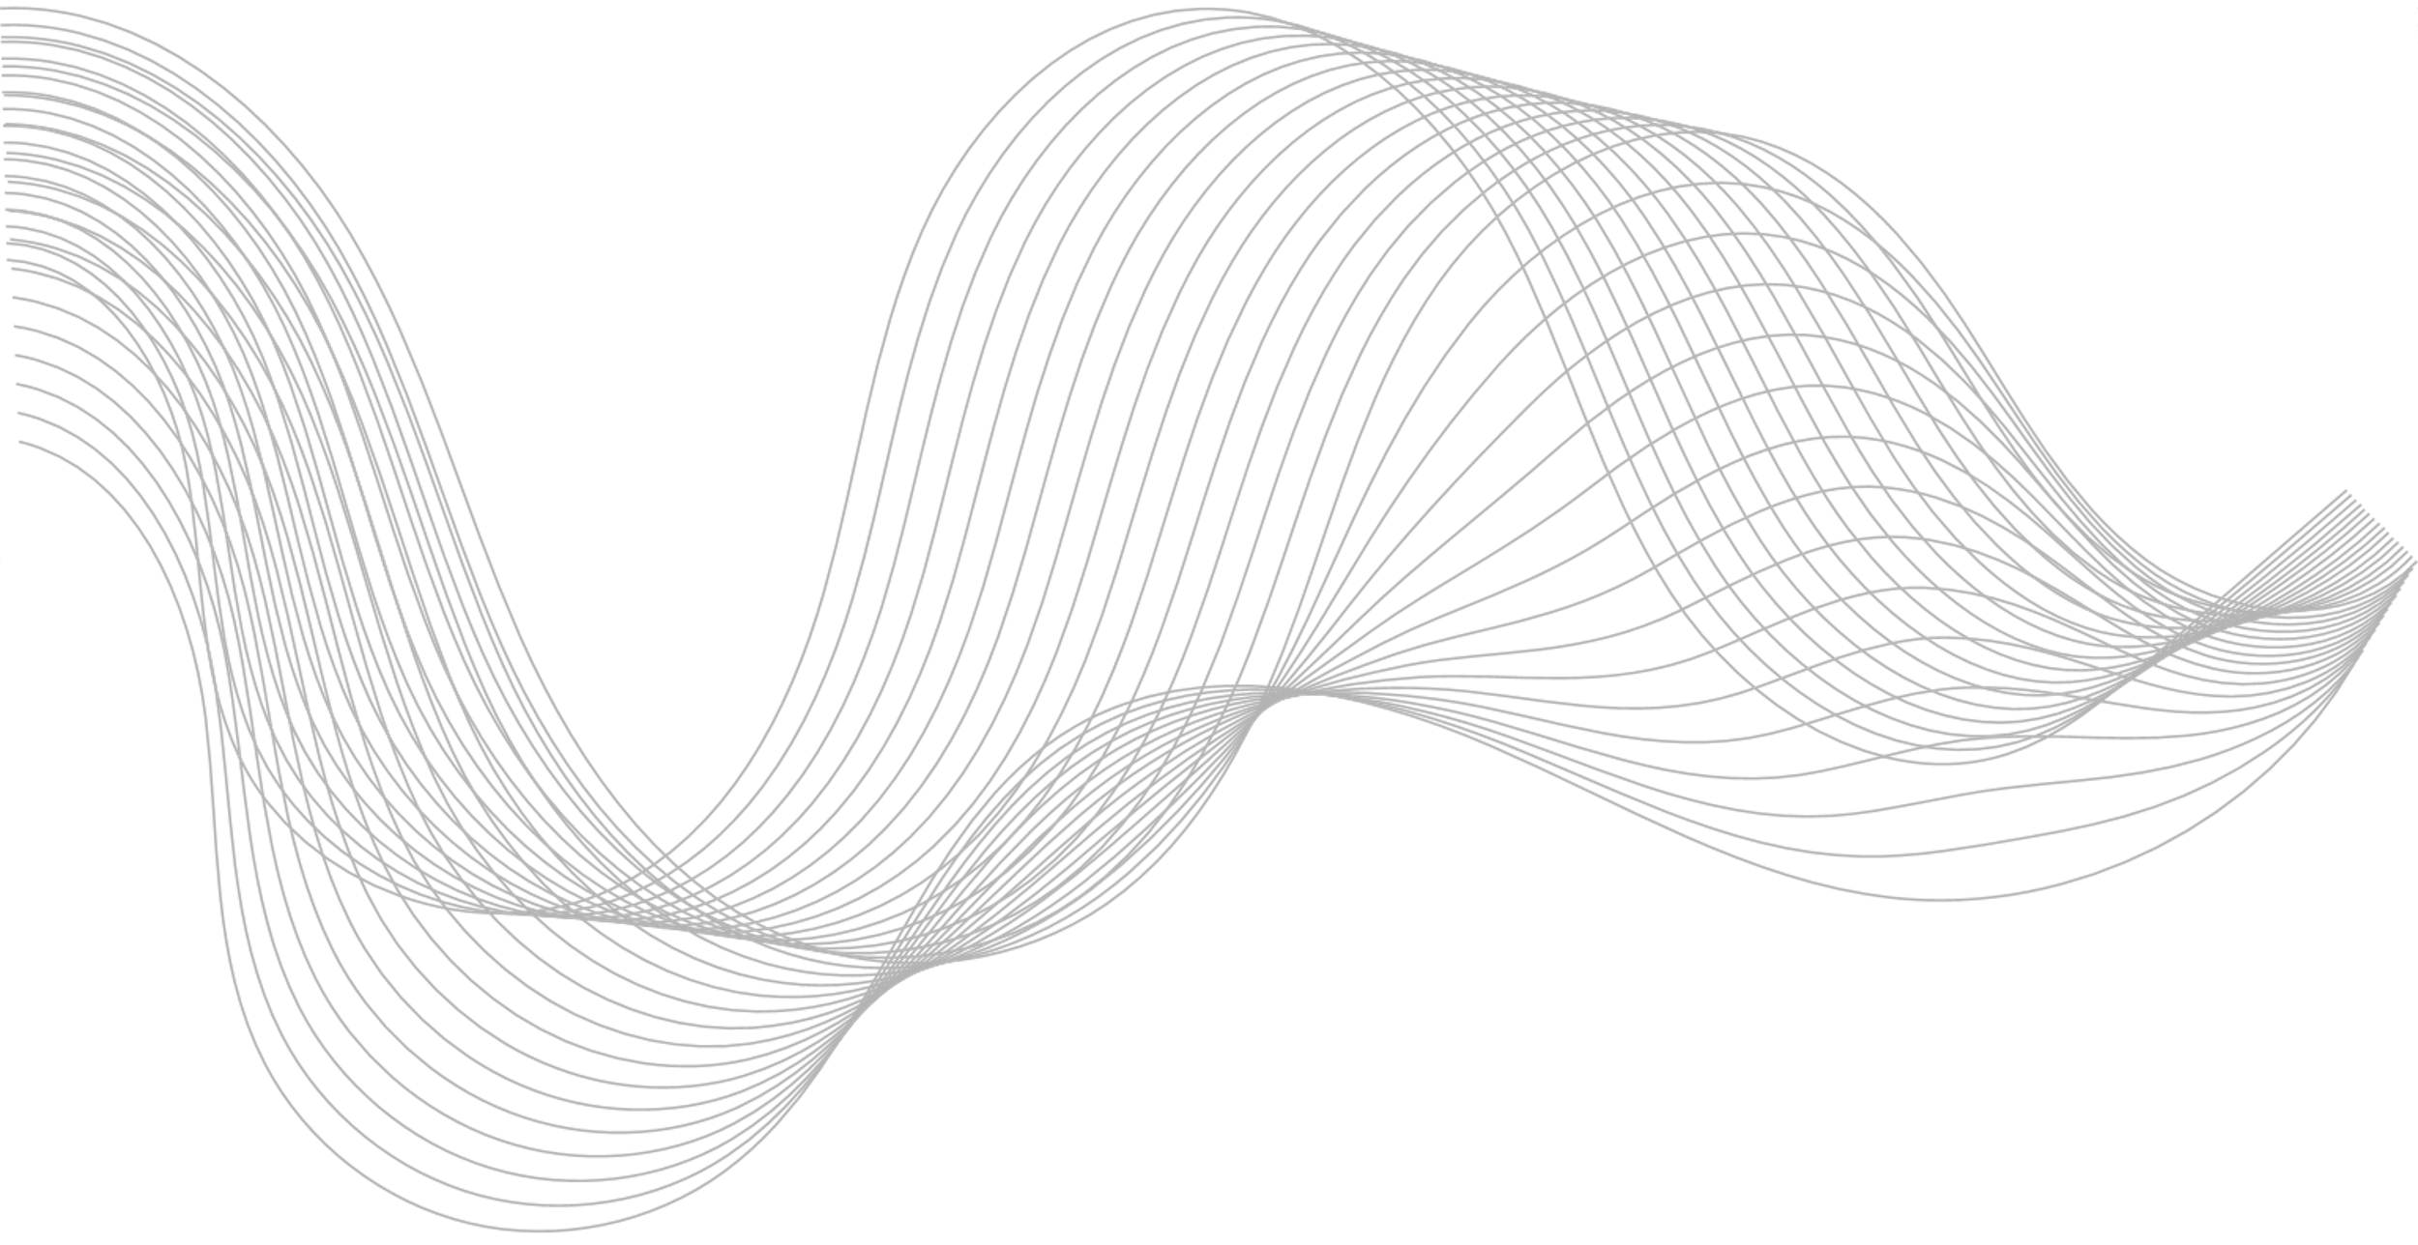
Image Copyright Protection Based on Blockchain and Zero-Watermark
Submitted by
Gouthami Kethavath (21JE0367)
Kush Milkesh Mistry (21JE0499)
Under the Guidance
Of
Prof. Sushanta Mukhopadhyay

Slide 2


PROBLEM STATEMENT
Images are often shared online without permission, causing copyright and ownership challenges.
Traditional watermarking methods degrade image quality and rely on third-party verification.
This project proposes a secure, decentralized system to verify image ownership without modifying the original image.

Slide 3

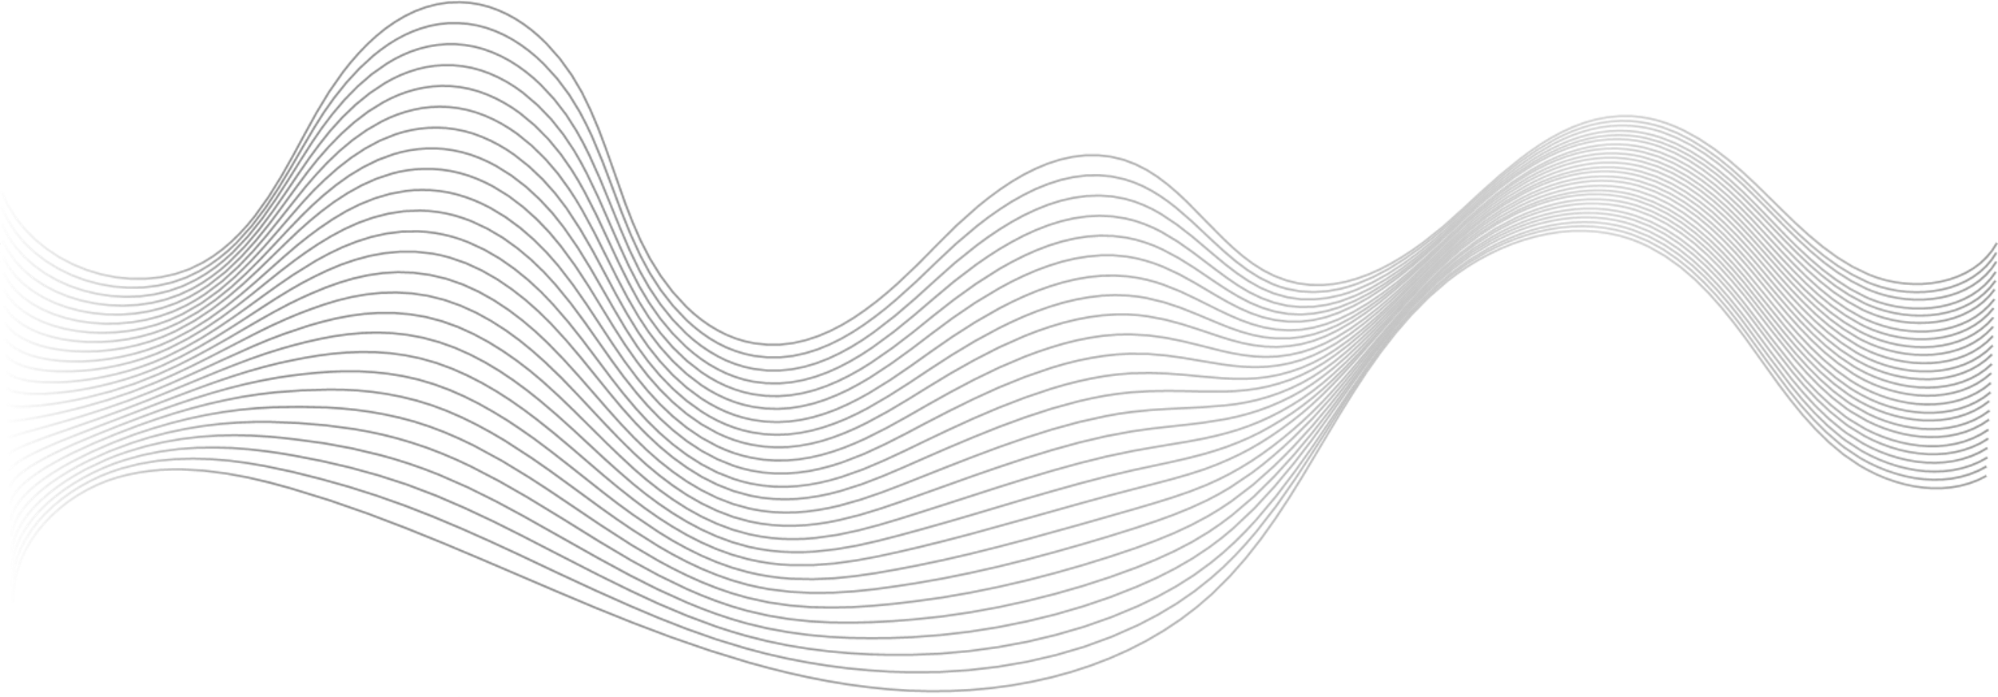

OBJECTIVES OF THE PROJECT
Main Goal: Combine zero-watermarking with blockchain to ensure tamper-proof, decentralized image ownership verification.
Preserve image quality.
Eliminate third-party intermediaries.
Secure storage using IPFS.

Slide 4
This process has two main phases::
1. Watermark Generation (Creating a zero-watermark)
2. Watermark Validation (Verifying authenticity)

Slide 5
ZERO-WATERMARKING AND
BLOCKCHAIN
Zero-watermarking is a technique where a watermark is generated without modifying the original image. Instead of embedding the watermark into the image, the algorithm extracts features from the image, combines them with the watermark, and stores the result in a secure storage system like IPFS

Slide 6


Original Image
Logo Image(Watermark Figure)
A PNG grayscale image with dimensions 1148 × 1525 pixels.
A PNG binary image with dimensions 128 × 128 pixels.

Slide 7
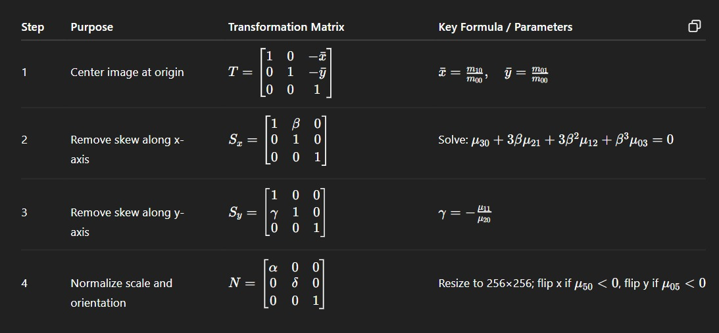
1. Watermark Generation
Step 1: Normalize the Original Image
This technique is used to standardize the image, making it resistant to geometric distortions like translation, rotation and scaling.
1024 x 1024

Slide 8
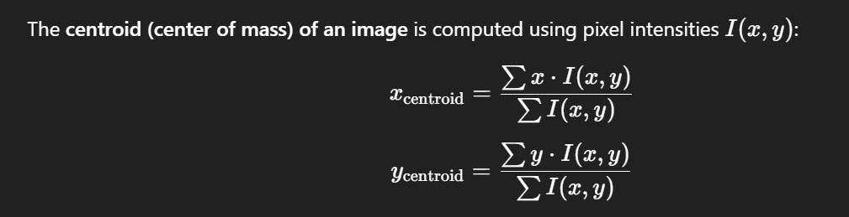

Each matrix is a 3×3 affine transform (homogeneous coordinates), and the final transform is:
$$M=N⋅S_{y}⋅S_{x}⋅T$$
The Resulting Image after the normalization with dimensions 1024 x 1024 pixels.
Step 2: Effective Region
Extract a 512 x 512 region centered at the centroid.

Slide 9
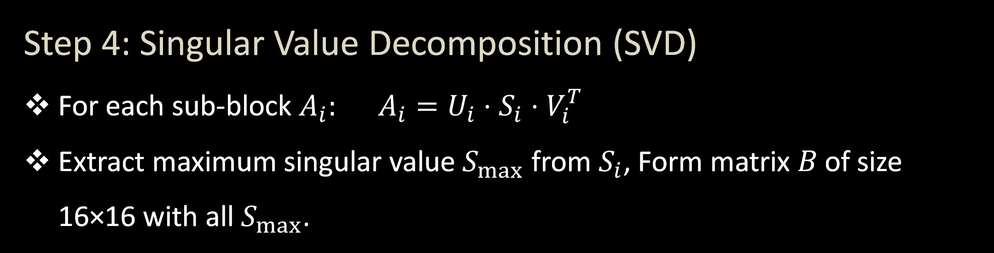
Step 3: Discrete Wavelet Transform & Sub-block Division
Apply 2-level Haar DWT to the 512×512 region.
First Level DWT (Divides 512 × 512 into four 256 × 256 sub bands: LL1, LH1, HL1, HH1).
Second Level DWT (Applies DWT to LL1 → four 128 × 128 sub bands: LL2, LH2, HL2, HH2).
Focus on LL2 sub band (low-frequency), Divide into sub-blocks.
Step 4: Singular Value Decomposition (SVD)
For each sub-block $A_{i}:$ $A_{i}=U_{i}⋅S_{i}⋅V_{i}^{T}$
Extract maximum singular value $S_{max}$ from $S_{i}$, Form matrix 𝐵 of size 16×16 with all $S_{max}$.

Slide 10
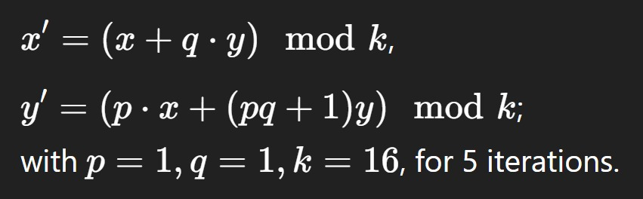

Step 5: Feature Image Generation
Convert each ​ $S_{max}$ in B to binary, extract Most Significant Bit (MSB),Set pixel in F to 1 if MSB is odd, else 0 → feature image F (16×16 binary).
Step 6: Scrambling with Cat Mapping
Scramble F and resized logo W (both 16×16) using Cat Map:
Outputs: Scrambled F′ and W′

Slide 11
Disadvantages of Cap Mapping:
Cat Map is a basic scrambling method.
Cat Mapping doesn't use random values for each image, so all images are scrambled in the same predictable way. This makes it easier for attackers to spot patterns and break the scrambling using comparison techniques.
Cat Map is periodic, so after a specific number of iterations, the scrambled image returns to its original form. This makes it vulnerable to attacks that simply track and reverse the process without knowing the scrambling key.

Slide 12
Dynamic Key- Based Scrambling Method:
Dynamic key-based scrambling ensures each image is scrambled uniquely by introducing a randomized key that changes for every image. This key is used to initialize chaotic maps (such as Henon, Lorenz, or Logistic maps), making the scrambling process highly unpredictable and difficult to reverse without knowledge of the key.
Benefits:
Stronger Security
Prevents Attacks
Blockchain Security
Highly Unpredictable

Slide 13
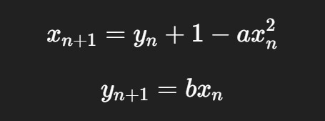
Here we considered the Henon Map Method:
What is the Henon Map?
The Henon map is a nonlinear Mathematical Model that generates chaotic sequences. It is widely used in image encryption because small changes in its parameters (𝑎, 𝑏 , iterations) lead to drastically different outputs. This makes the scrambling pattern highly unpredictable and secure against attacks.
𝑎 and 𝑏 are the control parameters (key).
𝑥𝑛 and 𝑦𝑛​ are the state variables.

Slide 14
Step 7: Zero-Watermark Generation
Bitwise XOR to generate watermark:
𝑣 = F’ (XOR) W’
Output: Zero-Watermark 𝑣 of size 16×16.

Slide 15

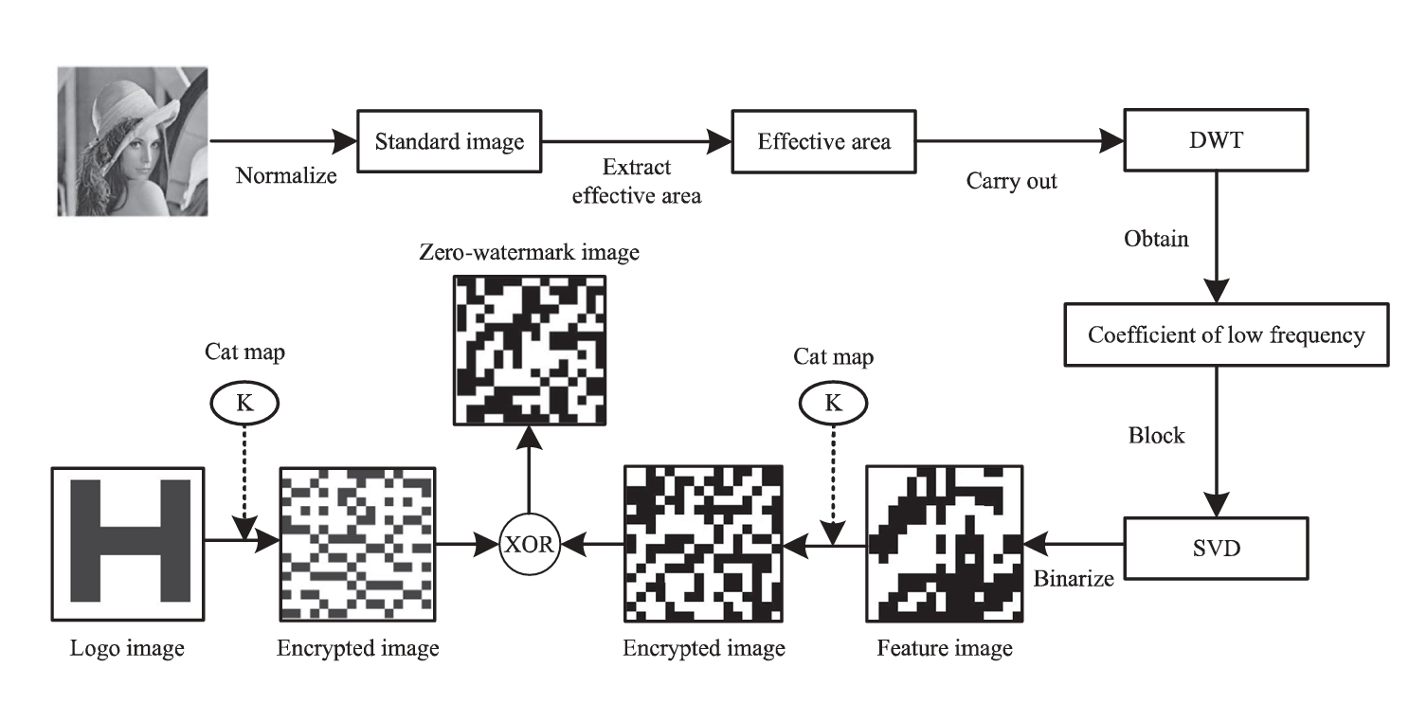
LL2 Band
Henon Mapping
Henon Mapping
Zero-watermark Generation flow chart.

Slide 16
Store the Zero-Watermark and Scrambling Parameters
The system includes two roles: Image Owner (IO) and Image Users (IU), ensuring data confidentiality and image security.
The Image Depository Contract is created by IO to store images, manage authorized users, and watermark data using mappings and structures.
KEY structure stores scrambling parameters, IPFS address of the watermark, and user identity.
The Image Validation Contract lets IU securely search and retrieve watermark data from the Depository Contract.

Slide 17
KEYINFO structure stores the retrieved scrambling parameters and IPFS address for IU use.
Ethereum addresses are used for role identification and secure interaction between contracts.
User Management: The Image Owner (IO) can add or remove Image Users (IUs) by modifying an authorization list, ensuring only trusted users can access image data.
Access Control: Only the IO can perform sensitive actions like adding/removing users and watermark data, verified through Ethereum address checks.
Watermark Storage: The IO can store watermark-related data, including scrambling parameters and IPFS hash, linked to a unique identifier like user email or image ID.

Slide 18
Data Deletion: The IO can delete previously stored watermark data using the corresponding identifier, ensuring outdated or invalid entries are removed.
Search Functionality: Both IO and authorized IUs can securely search for watermark data using an identifier, and retrieve associated parameters if access is validated.
Security Assurance: All functions enforce access control, ensuring that only permitted addresses can view or modify sensitive image and watermark information.

Slide 19
The Constructor initializes the Image Validation Contract with the address of the Image Depository Contract and sets the Image User (IU) as the owner.
The Search function allows the IU to fetch watermark data securely by interacting with the Image Depository Contract and storing results internally.
The Get Result function lets only the IU retrieve the fetched data, ensuring data confidentiality through access control.

Slide 20
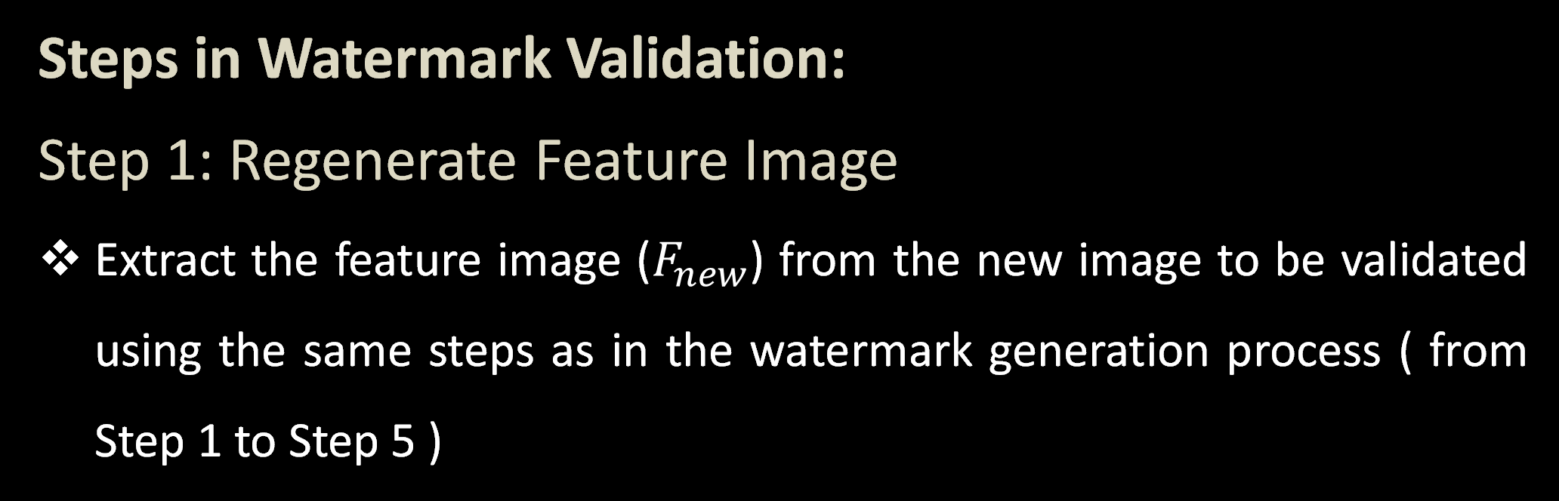
2. Watermark Validation
Watermark validation is the process of verifying the authenticity of an image by recovering the original logo image using a zero-watermark and comparing it to the stored logo. If the similarity score exceeds a threshold, the image is authenticated as genuine.
Steps in Watermark Validation:
Step 1: Regenerate Feature Image
Extract the feature image ($F_{new}$) from the new image to be validated using the same steps as in the watermark generation process ( from Step 1 to Step 5 )

Slide 21


Step 2: Scramble the Regenerated Feature Image
Apply the Henon mapping to the regenerated feature image $F_{new}$ using scrambling parameters from the blockchain (a , b , iterations) to obtain ${F′}_{new}$ .
Step 3: Recover the Scrambled Logo Image
Retrieve the zero-watermark image (v) from IPFS using the blockchain address. Perform a bitwise XOR operation:
${W′}_{new}$= 𝑣 ⊕ ${F′}_{new}$ to reverse the watermark generation process.

Slide 22
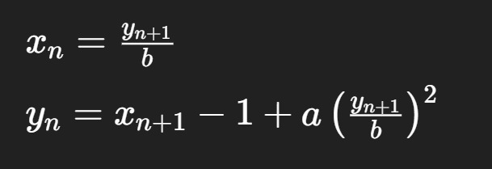
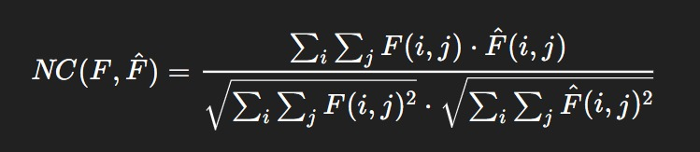

Step 4: Recover the Logo Image and Verify Authenticity
Inverse Henon Mapping: Apply the inverse Henon mapping to ${W′}_{new}$using the same scrambling parameters (a, b , iterations) to recover the logo image ($W_{new}$).
Step 5: Compare Logos
Compare the recovered logo image with the original logo image, using the average Normalized Correlation value (NC), calculated as:-

Slide 23

Where F and $\hat{F}$ represent the original and the recovered logo image respectively, and the value of NC is a decimal number less than 1. The larger the value, the better the restored watermark effect will be.
Step 4: Decide on Authenticity
If NC value > 0.80, copyright authentication is successful.
If NC value ≤ 0.80, copyright authentication fails.

Slide 24
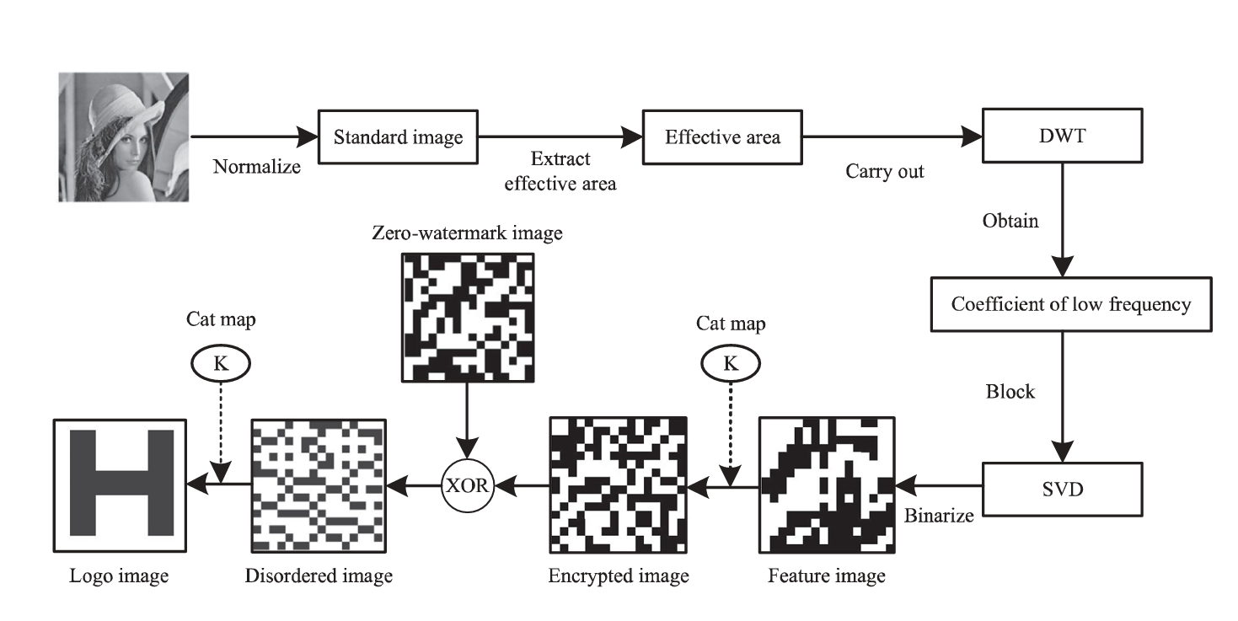
Test Image
Original logo
Inverse Henon Mapping
Henon Mapping
LL2 Band
Matching bits
Scrambled logo of test image
Zero-watermark validation flow chart.

Slide 25
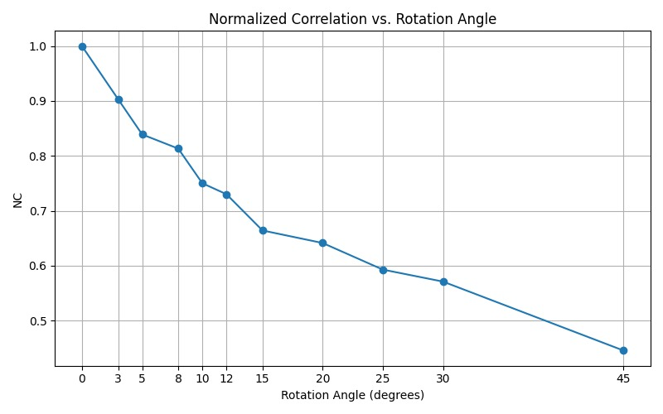
Performance Test:
1. Rotation Attack

Slide 26
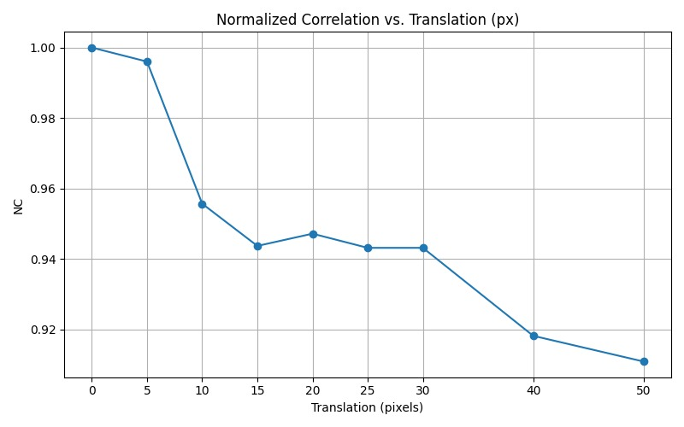
2. Translation Attack

Slide 27
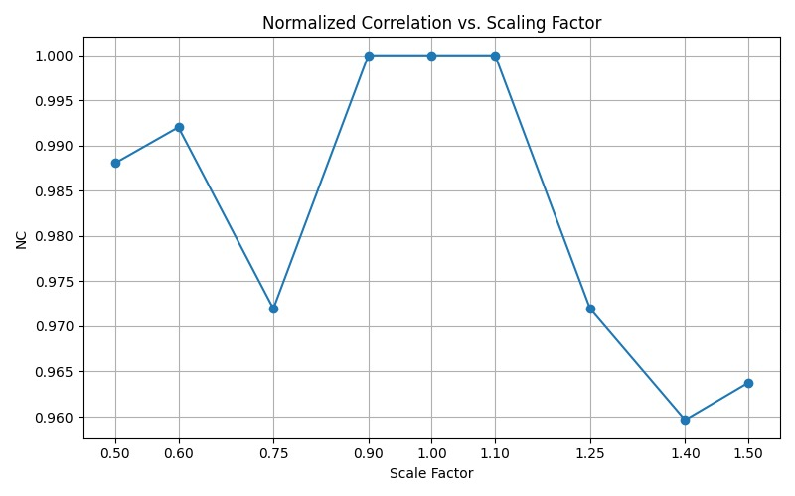
3. Scaling Attack

Slide 28
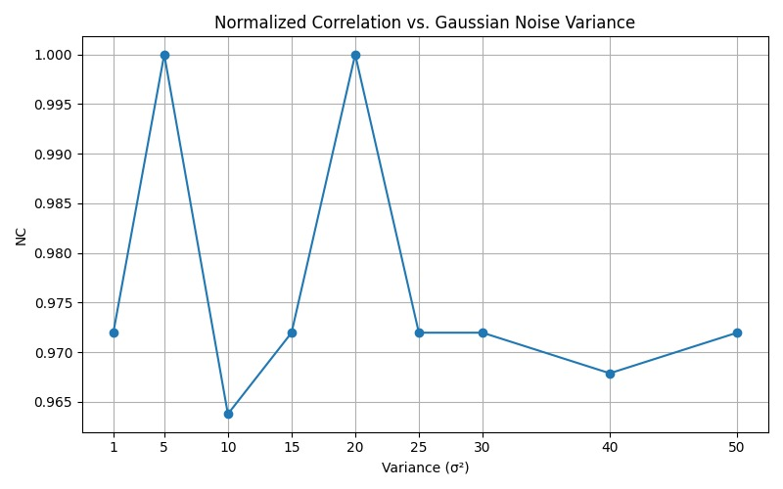
4. Gaussian Noise Attack

Slide 29
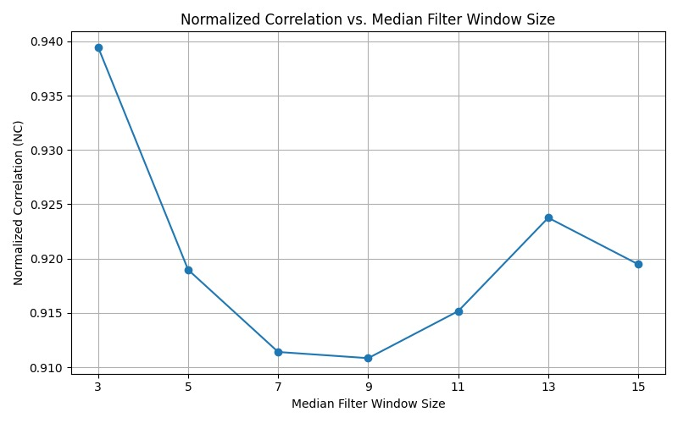
5. Median Filtering Attack

Slide 30
Conclusion
This project combines zero-watermarking with blockchain to ensure tamper-proof and decentralized image ownership verification. It removes the need for third-party trust by securely storing watermark data on IPFS and Ethereum smart contracts.
In the future, we extend the system to support color images and video watermarking using advanced chaotic maps.

Slide 31
Project Link
https://github.com/Kush27110405/Final_Year_Project

Slide 32
THANK YOU

